Slide 1

Analysis of Image Steganography with LSB and DCT
By: Rishav Acharya

Slide 2

Table of Content
Introduction
Literature Review
Objective
Methodology
Implementation
Result and Analysis
Conclusion

Slide 3
Introduction
Steganography
Art of hiding message in form of image, audio, video
Discrete Cosine Transform
An image compression technique which divides the image from spatial domain to the frequency domain.
Least Significant Bit
An common method for insertion of message in an image.

Slide 4
Literature Review
In paper [1], the author has discussed about the methods of Steganography using LSB and DCT based Steganography and performed an analysis using MSE and BER on embedded steganographic images
In paper [2], the author has presented an analysis of LSB and DCT based Steganographic techniques using PSNR evaluation method.
In paper [3], the authors has presented a comparison of two different techniques; LSB with no encryption and no compression and DCT where secret message is encrypted first then LSB technique is applied.

Slide 5
Objective
To present a technique that can be used as cryptographic scheme during data transmission.

Slide 6
Methodology
Both DCT and LSB method of Steganography is used in this seminar.
Encryption and Decryption methods are used separately for both the steganography techniques.
Error evaluation is also done by using Mean Square Error (MSE) and Peak Signal to Noise Ratio (PSNR).
Histogram analysis is also done for all the image used in this process.

Slide 7
Implementation
Modules Used
PIL Fork is used to read, copy, modify pixel and to save image
OS is used to direct files to given directory in the system.
Shutil is used to delete entire directory from system in order to remove the conflict.
CV2 is used to read, write and tilt the color space of image in this seminar report.
XLwt is used to generate excel file of the error calculation between cover and steganographic images.

Slide 8



Result
Cover vs Steganographic Image
Steganographic image (LSB)
Cover Image
Steganographic image (DCT)

Slide 9
Analysis
Visual Assessment Analysis
MSE (dB) | PSNR (dB)
MSE (dB) | PSNR (dB)
0.0733 | 59.4789
6853.5814 | 9.7716
LSB based Steganographic Image
DCT based Steganographic Image
Cover Image
The low MSE value, the best model.
The high PSNR value, the high quality image.

Slide 10
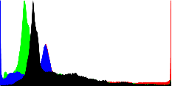
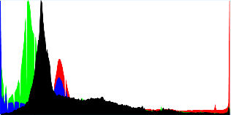
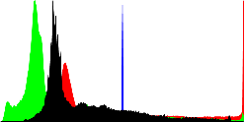
Analysis
Statistical Analysis (Histogram Analysis)
LSB based Steganographic Image
Cover Image
DCT based Steganographic Image
Steganographic image under LSB is identical to cover image.
Steganographic image under DCT has some distortion.
The more distortion in histogram the more security measure imposed.

Slide 11
Conclusion
Discusses in detail about the LSB and DCT algorithms on steganography application.
The evaluation is conducted for steganographic images.
The low MSE value, the best model.
The high PSNR value, the high quality image.
Histogram Analysis is conducted for all the images.
The more distortion in histogram the more security measure imposed.

Slide 12

Thank You

